Slide 1
Emotion and Lie Recognition from EEG signals using Deep Learning

Slide 2
ONE LINE PITCH OF THE IDEA
Implementing State of the Art algorithms for Emotion Recognition from Multi-Channel EEG brain signals which can help in determining the thoughts and emotions of an individual.

Slide 3
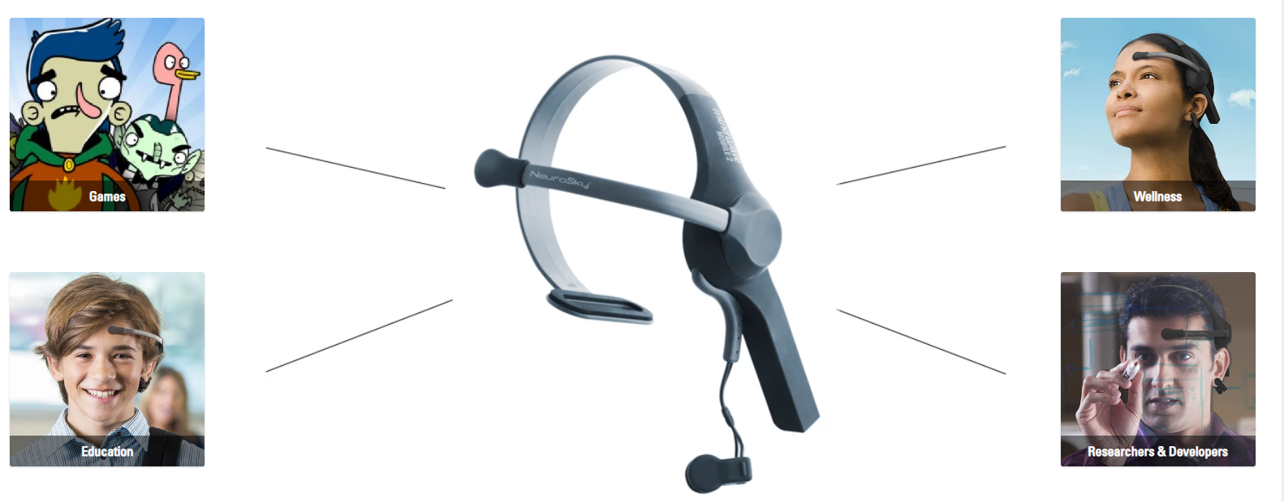

Slide 4
Dimensions of emotion:
Valence (positive, negative - the pleasantness of the stimulus)
9: happy, pleased, satisfied, contented, hopeful
1: unhappy, annoyed, unsatisfied, melancholic, despaired, or bored
Arousal (strong, weak - the intensity of emotion provoked by the stimulus)
9: stimulated, excited, frenzied, jittery, wide-awake, or aroused
1: relaxed, calm, sluggish, dull, sleepy, or unaroused;
Control (dominance - the degree of control exerted by the stimulus)
9: in control, influential, important, dominant, autonomous, or controlling
1: controlled, influenced, cared-for, awed, submissive, or guided

Slide 5
Arousal and Valence from the basic axis for most of emotions.
Dominance detects the control on the mind.
Liking and Familiarity detect how much a person likes or is familiar with something. This is used for lie detection.

Slide 6
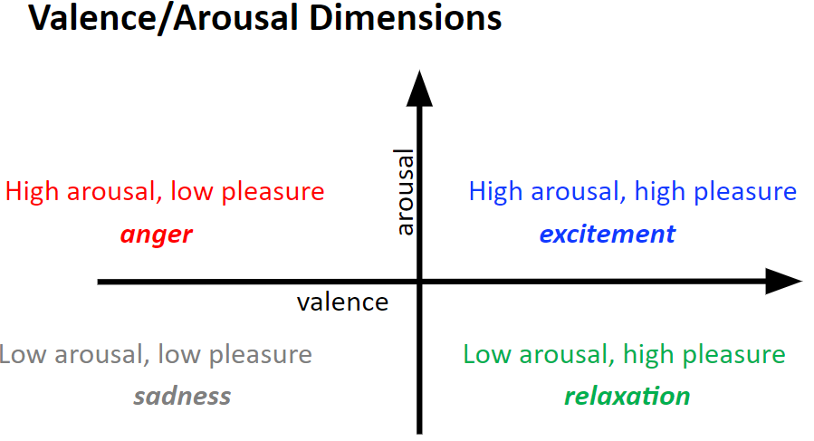

Slide 7
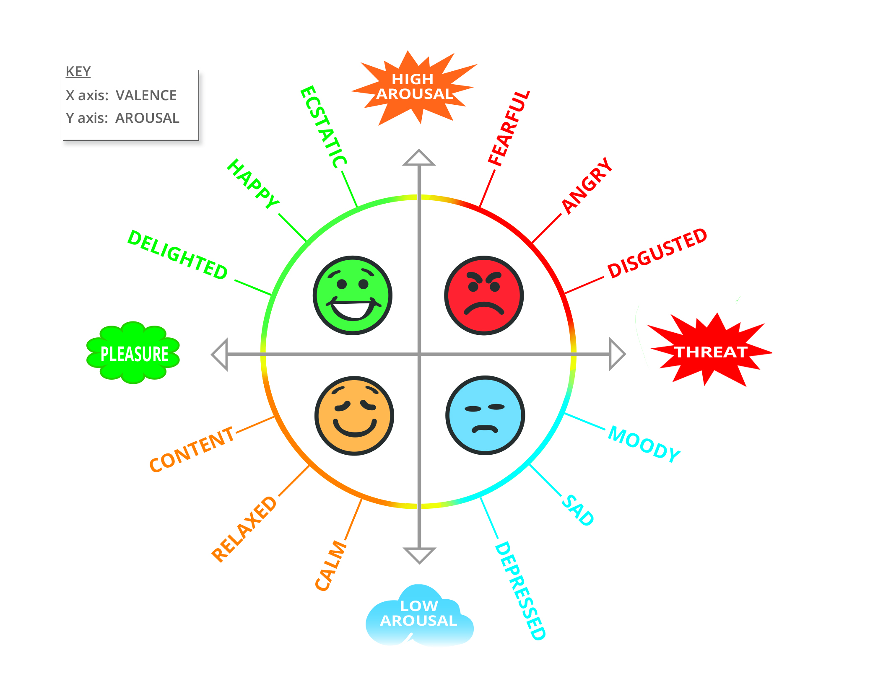

Slide 8
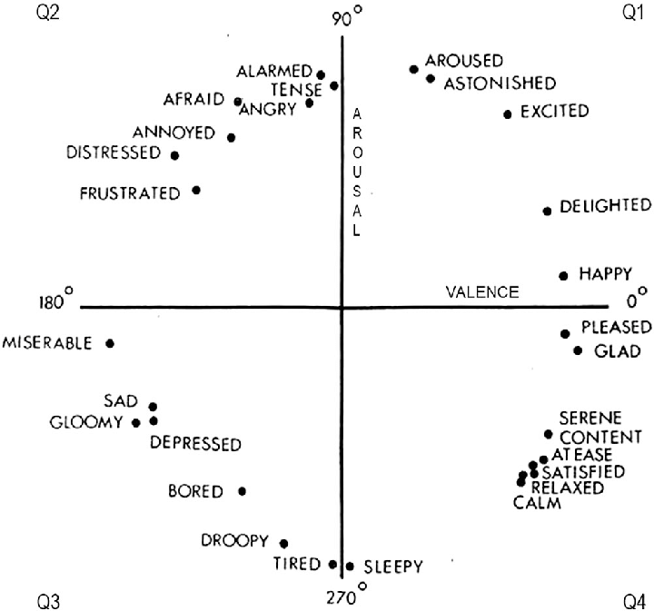

Slide 9
Specialised application software!
Specialised military and police applications.
For training (tracking cadet’s mental state).
Detecting stress in drivers, pilots, cadets.
For criminal interrogation (will keep a check on crime rate).
Lie detection (polygraphs test can be faked but brain signals can’t be).
Would prove to be a MAJOR ADVANTAGE.

Slide 10
Groundbreaking innovation in the field of healthcare!
Detecting mental state of babies, autistic / mentally paralysed patients / specially abled people / patients in coma / trauma patients / feedback for how someone is being treated.
Psychology and Neurology in diagnosis of patients.
Helping psychiatrists to deal with patients better as they’ll have a better understanding of their emotion.
Indicating post traumatic stress disorders, major depression and anxiety.
Researches show with the help of valence, arousal and dominance, we can measure levels of burnout and productivity.
Fits / Seizure diagnosis.

Slide 11
Future Enhancements
Education
Detecting confusion in students (would enhance e-learning).
Webinar feedbacks.
Honest Feedbacks
Sentiments towards politicians, products, countries, ideas, personalities, ideologies,movies, music, games, etc.
Luxury Uses
Automating lighting conditions and room environment (fragrance, temperature etc.) according to the emotions user is experiencing.

Slide 12
Evolutionary in Entertainment & Gaming Industry :-
Could generate great revenues by having a gripping effect on the players / viewers:
Making games more interactive based on user’s emotional state and indulgence. Example: first person shooters, strategy games, racing, arcade, fighting, RPG, open-world games, virtual reality, altering the storyline to player’s interests.

Slide 13
Better than MRI’s and invasive BCI’s

Slide 14
Facebook is currently investing a lot in BCI program outlining their goal to build a non invasive, wearable device that lets people type by simply imagining themselves talking.

Slide 15
SOLUTION
As a challenging pattern recognition task, automatic real time emotion recognition based on multichannel EEG signals is becoming an important computer aided method for emotion disorder diagnose in neurology and psychiatry. Traditional machine learning approaches require to design and extract various features from single or multiple channels based on comprehensive domain knowledge
Consequently , these approaches may be an obstacle for non domain experts. On the contrast , deep learning approaches have been used successfully in many recent literatures to learn features and classify different types of data.
A hybrid neural network which combines ‘Convolutional Neural Network (CNN )’ and ‘Recurrent Neural Network (RNN)’ has been applied to classify human emotion states by effectively learning compositional spatial temporal representation of raw EEG streams . The CNN module is used to mine the inter channel correlation among physically adjacent EEG signals by converting the chain like EEG sequence into 2D frame sequence. The LSTM module is adopted to mine contextual information.
Experiments are carried out in a segment level emotion identification task, on the DEAP benchmarking dataset

Slide 16
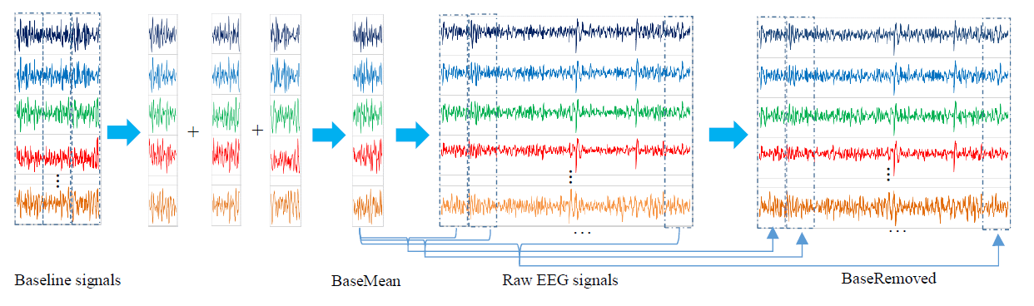
Pre-Processing

Slide 17
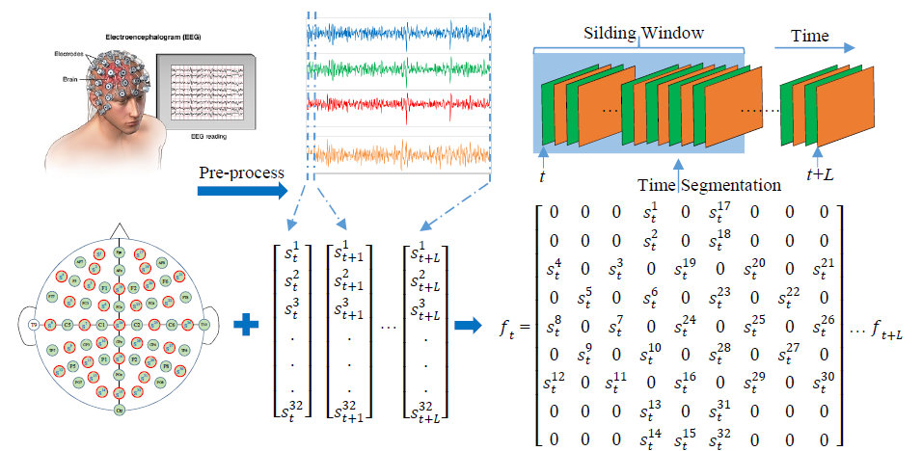
Converting 1-D EEG signals to 2-D frames

Slide 18
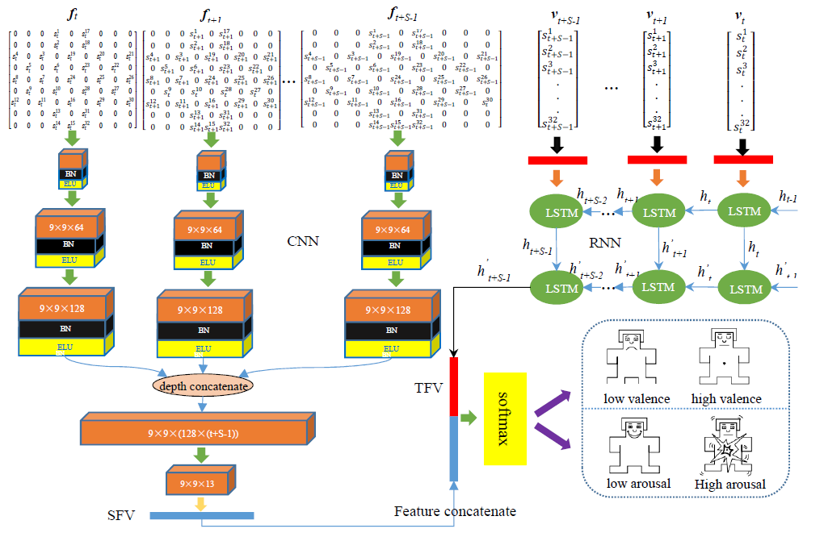
Parallel Convolutional-Recurrent Neural Network

Slide 19
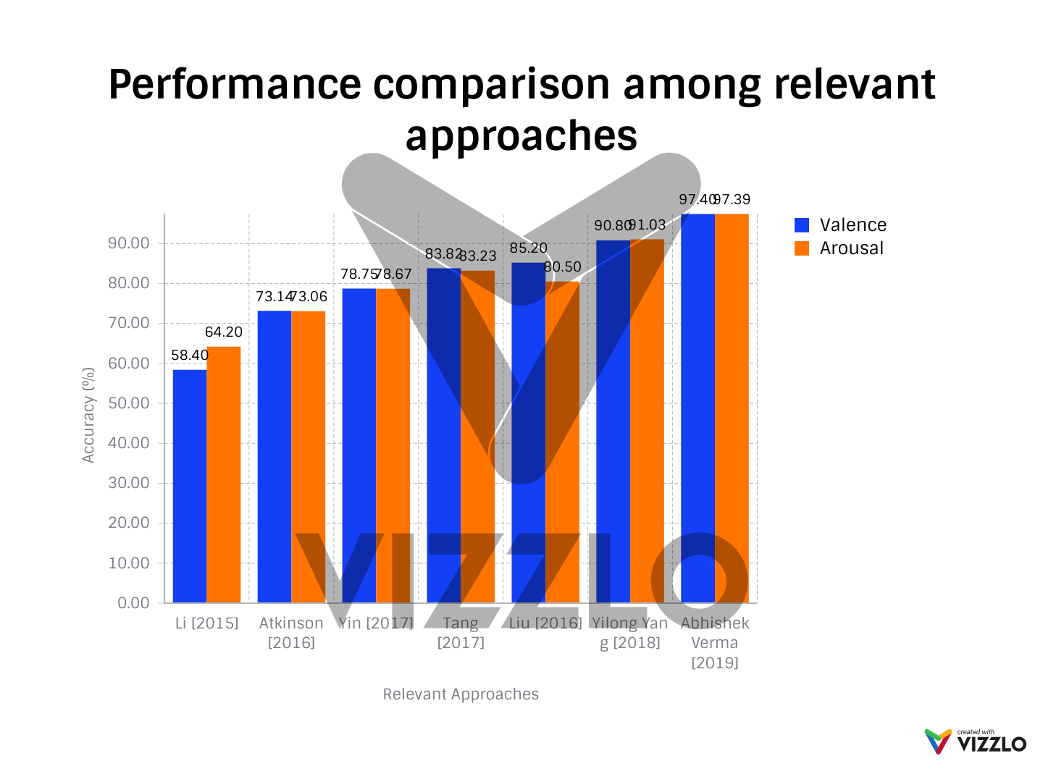

Slide 20
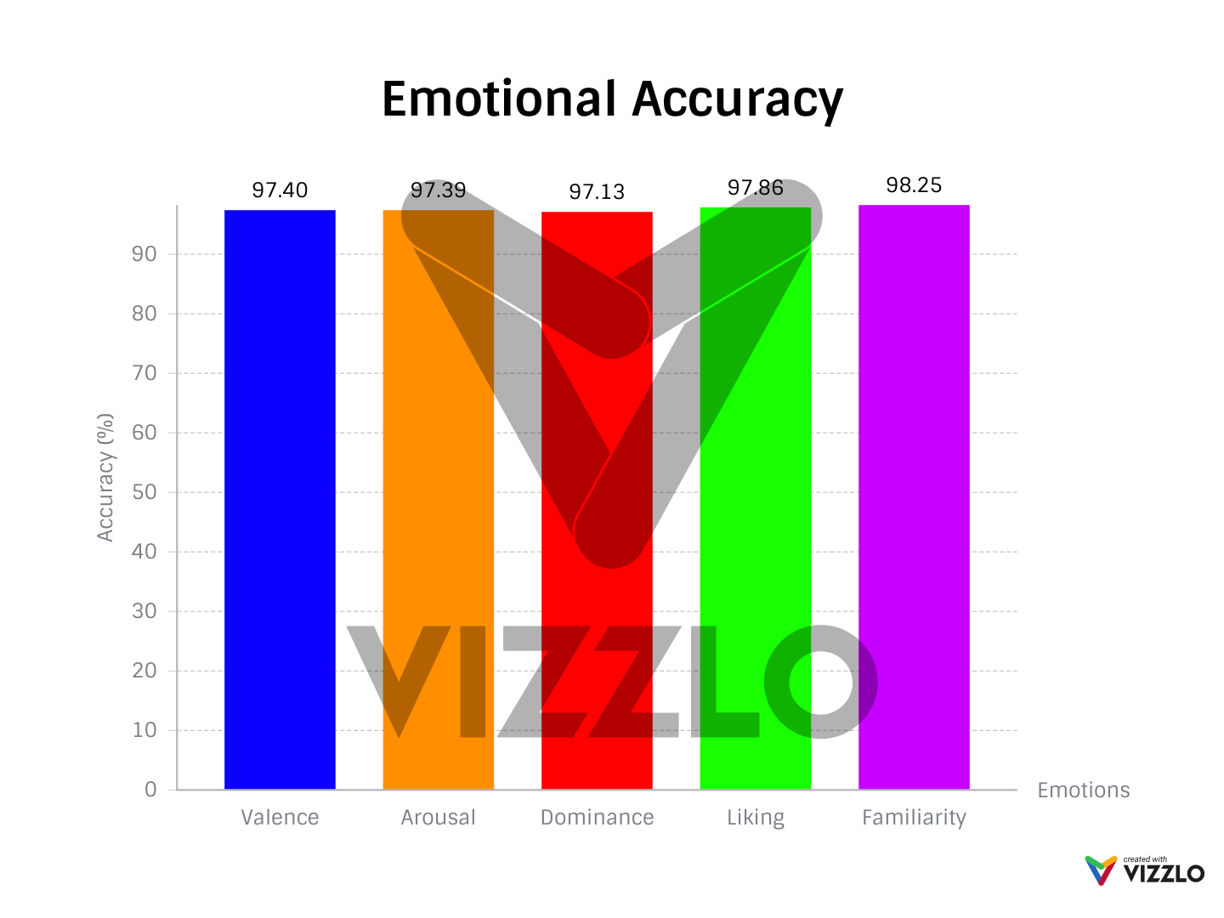
Emotion graph
Innovations over other relevant approaches

Slide 21
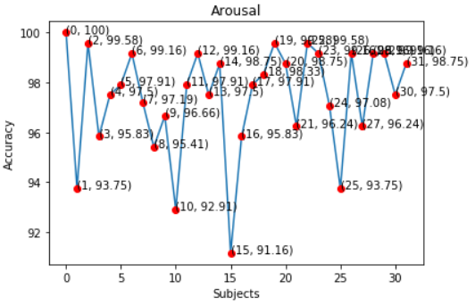

Slide 22
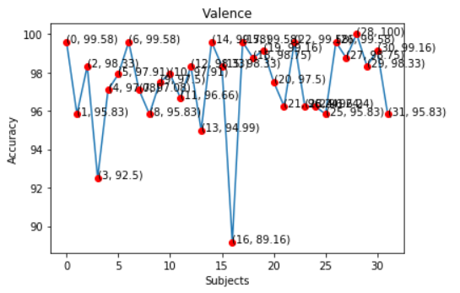

Slide 23
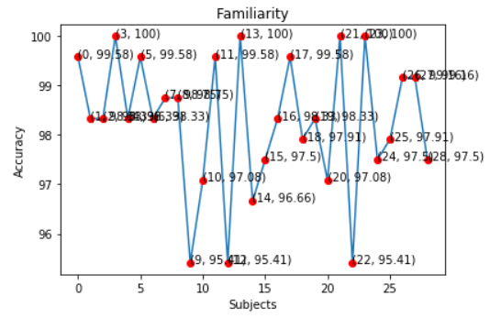

Slide 24
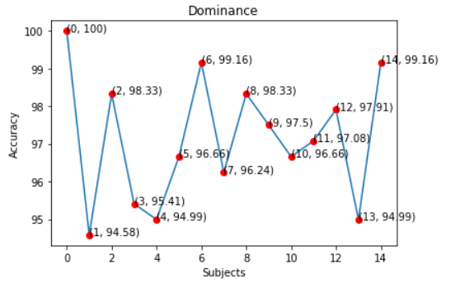

Slide 25
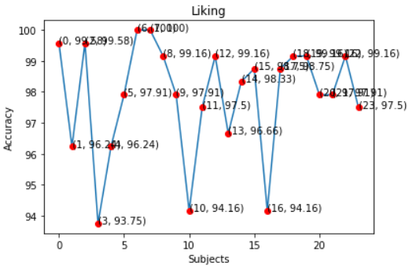

Slide 26
THANK YOU

